Slide 1

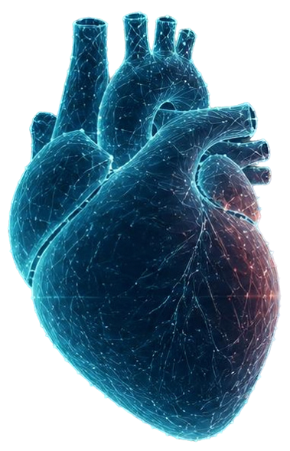
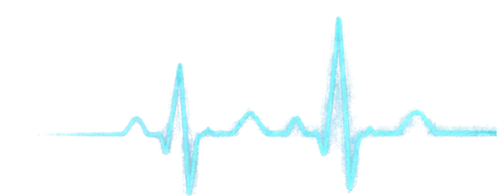

SHARE Digital Twin:
An Exploratory Cardiovascular Digital Twin Using ECG-Derived Heart Rate Variability
Happiest Health Digital Twin Challenge 2026
BVCITS, Batlapalem, Amalapuram
Team
Vijaya Durga Lavanya Kothapalli
Leela Lakshmi Prasanna Karatam
Durga Swetha Sri Kamana
Suji Muramalla
Our Vision
Representing physiological changes over time
to enable dynamic cardiovascular insights

Slide 2


The Problem
A single snapshot misses the
dynamics of physiology.
We use windowed ECG-derived
HRV features to capture change over time.
Patient-specific baselines personalize
what is normal for each individual.
The Twin State deviation metric
quantifies the magnitude of change.
Trajectory visualization reveals
temporal patterns and trends.

Slide 3

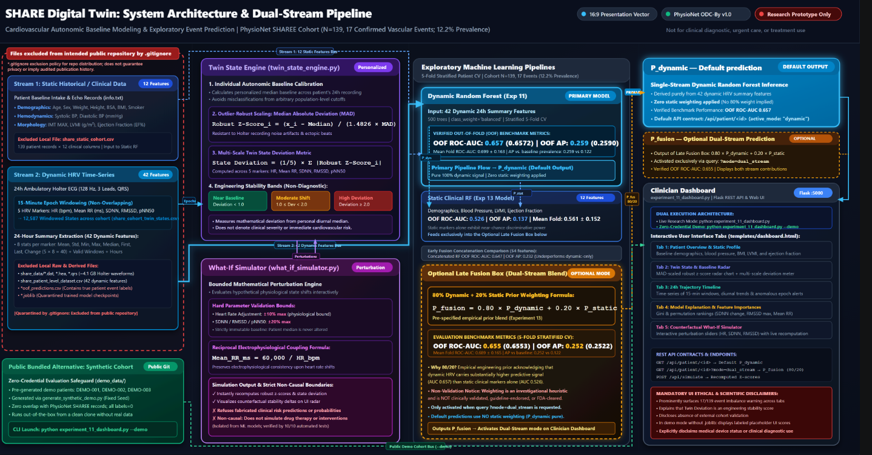















System Architecture
A modular pipeline that ingests clinical and HRV data, models individual twin state, and delivers insights.
SYNTHETIC PUBLIC DEMO
ENVIRONMENT
INPUT LAYER
Deployed separately
Static
clinical
data
RESEARCH PIPELINE (EXPLORATORY)
FLASK DASHBOARD
demographics
medical history
labs, vitals
Twin State insights
and trajectories
TWIN STATE
ENGINE
EXPLORATORY
MACHINE-LEARNING
EVALUATION
TWIN STATE
DEVIATION
AGGREGATION
Patient-specific baseline calibration
robust scaling using median absolute deviation (MAD)
INPUT LAYER
Research models assess patterns
and associations
Not for clinical use
Dynamic
ECG-derived
HRV features
Quantifies deviation
magnitude over time
WHAT-IF SIMULATOR
Explore scenarios
with synthetic data
time- and
frequency domain
features
Data flow
Component boundary

Slide 4

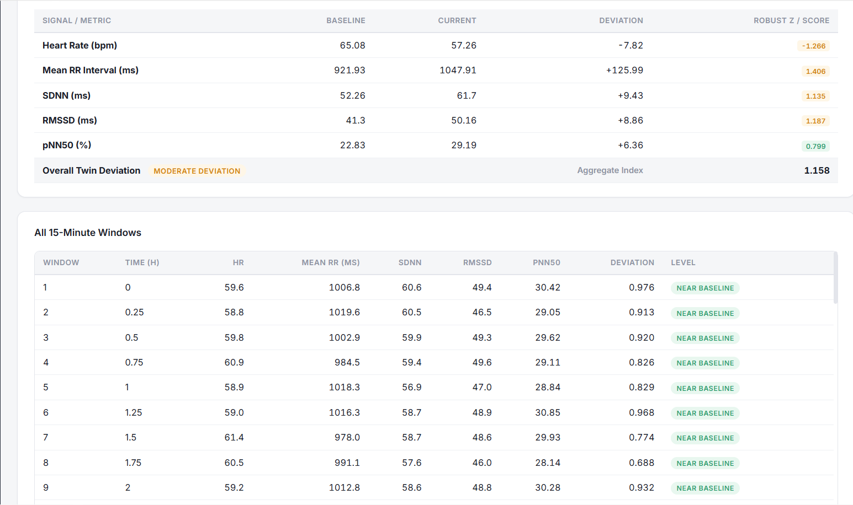







15-MINUTE WINDOWING APPROACH
Windowed HRV Inputs
ECG-DERIVED
HRV FEATURE
WHAT IT MEASURES
WHY IT MATTERS
ECG Signal
15-Minute Windows
HR_ bpm
Reflects overall heart rate
and autonomic balance
Beats per minute
1
2
3
•••
96
Average time between heartbeats
Captures baseline cardiac rhythm
Mean_RR_ms
24 Hours
00:00
24:00
SDNN_ms
Variability in all RR
intervals
Indicates overall HRV and physiological resilience
96
WINDOWS
Each window produces
five HRV features to capture change over time.
RMSSD_ms
Short-term variation
in RR intervals
Sensitive to parasympathetic (vagal) activity
PER 24 HOURS
Percentage of successive RR intervals differing
by >50 ms
Highlights rapid autonomic shifts and recovery capacity
Synthetic demonstration setup: 24-hour ECG segmented into 96 windows for explorory analysis.
pNN50 percent

Slide 5









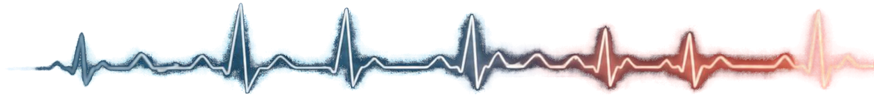
Twin State Methodology
Establish each patient’s
median baseline.
01
TWIN STATE THRESHOLDS
<1.0
Near Baseline
02
Compute robust z-scores
using median absolute deviation.
1.0 ​​to <2.0
Moderate Deviation
03
Aggregate absolute deviations
to summarize feature shifts.
>2.0
High Deviation
Calculate the Twin State
deviation metric.
CAVEAT: These thresholds are engineering heuristics, not clinically validated.
04

Slide 6


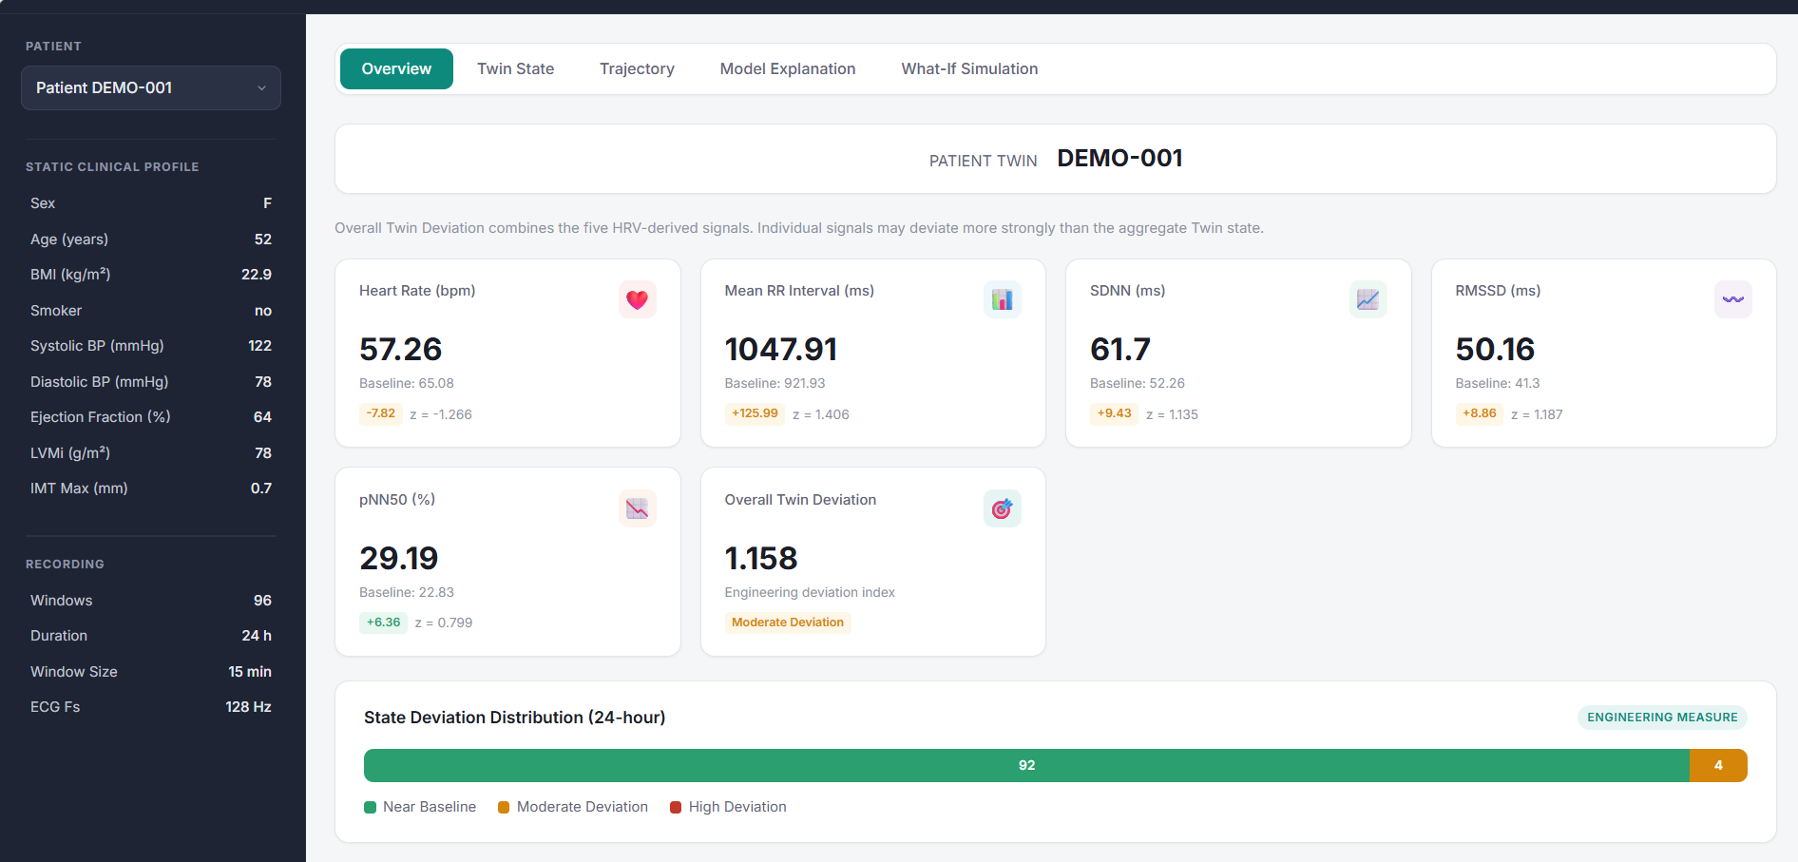
Dashboard Demonstration
Live demo of SHARE Digital Twin Overview
The overview dashboard brings integrated physiology to life.
Genuine SHARE Digital Twin Overview Dashboard Screenshot
It reveals individual baselines, change over time, and
trajectory patterns.
All metrics are derived from
windowed ECG-based HRV.
Using fictional synthetic patient data for demonstration.

Slide 7

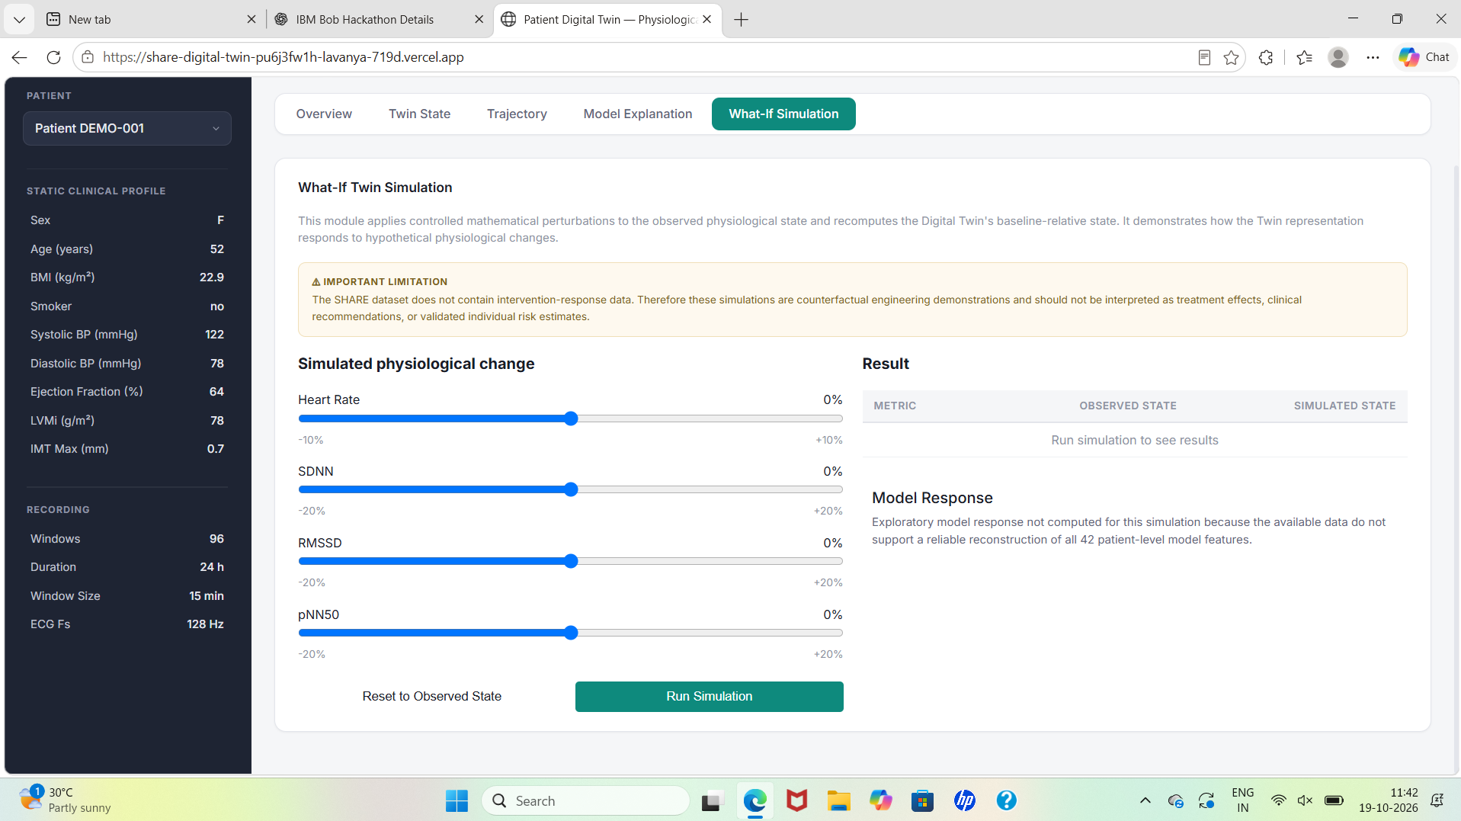

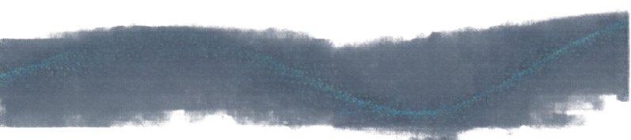
What-If Simulation
Apply controlled mathematical perturbations to HRV inputs.
Recalculate baseline relative Twin State deviation in real time.
GENUINE WHAT-IF SIMULATOR SCREENSHOT
Visualize scenario outcomes instantly without intervention data.
This simulator does not predict treatment effects or validated individual risk.

Slide 8





Exploratory Research Results
Out-of-fold ROC-AUC performance across model approaches.
ROC-AUC
1.0
0.8
0.6
0.4
0.2
0.0
0.6572
0.6553
0.526
Dynamic-only model
Static-only
model
Dual-stream
late fusion
patients total
These findings are exploratory research. They do not represent clinical validation or live predictions.
139
17
vascular-event cases
Data source: Windowed ECG-derived HRV features from SHARE Digital Twin exploratory dataset.
Caveats: Small cohort with class imbalance. Results may not generalize beyond this dataset.

Slide 9




Testing, Limitations, and Next Steps
TESTING SCOPE
40 tests conducted
3 skipped due to requirement for
real SHARE data or real-data mode
KEY LIMITATIONS
Small number of positive vascar-event cases limits statistical power
Synthetic demo does not reflect real patient data dynamics
Missing intervention response data restricts prediction validity
External validation required for clinical use
NEXT STEPS
Incorporate real SHARE data when available
Enhance model robustness with larger cohorts
Validate thresholds clinically

Slide 10


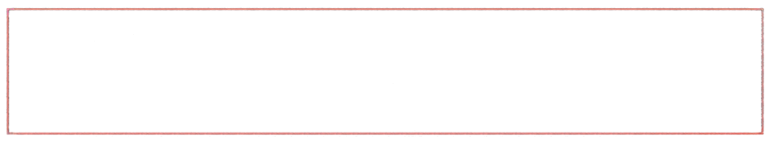

Conclusion
Baseline relative Twin State representation
enables personalized dynamic cardiovascular insights.
Trajectory visualization supports temporal
interpretation of physiological changes.
What-If simulation of hypothetical states
advances research understanding.
This is an exploratory research prototype, not a clinical decision tool.
We invite continued research and external
validation to advance the SHARE Digital Twin vision.

